Slide 1

CHURN PREDICTION
LEOMAR FONSECA

Slide 2

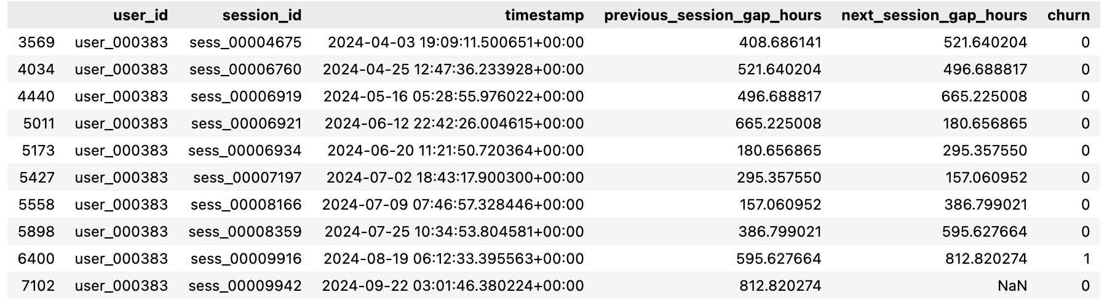
CHURN PREDICTION
STAGE 1 - DEFINITIONS
Goal: develop a churn prediction model that identifies users at risk of churning within the next 30 days.
Evaluation metrics: recall (and accuracy).
Application example: user_000383
Column created using timestamp information to “look forward”
Rows removed from the dataset, since there is no churn information available

Slide 3
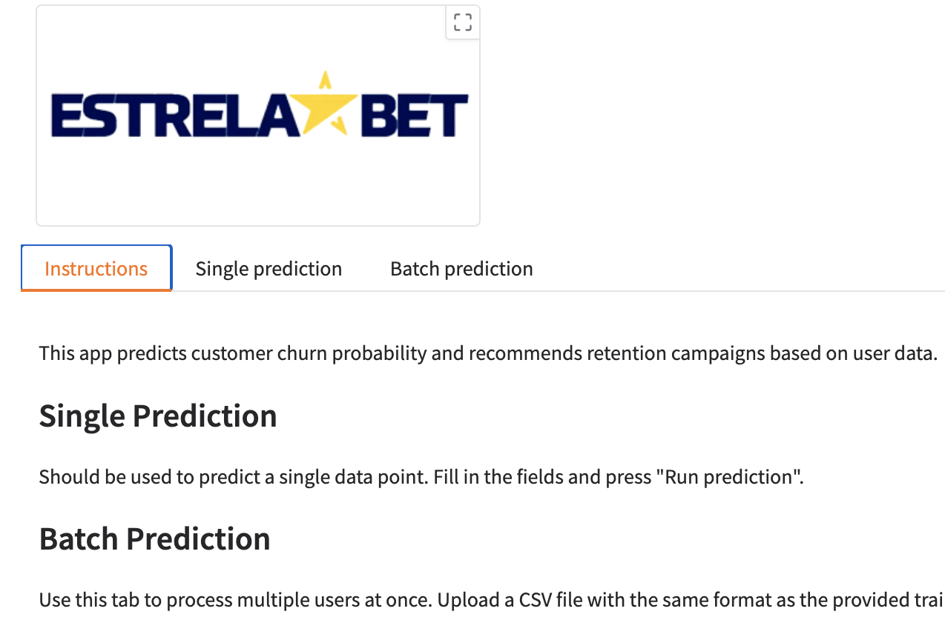
CHURN PREDICTION
STAGE 2 - MODELING
IMBALANCED CLASS: 21.28% OF CHURN
THE VAST MAJORITY OF THE DATA POINTS WAS FROM THE BRONZE TIER (CLV)
ONLY THE BRONZE TIER HAD CHURN
THE DIAMOND TIER (CLV) BRINGS THE MOST REVENUE ON AVERAGE TO THE COMPANY
EXPLORATORY DATA ANALYSIS (EDA)
FEATURE ENGINEERING
FEATURE SELECTION
BASELINE MODEL
PREDICTIVE MODEL
APPLICATION/REPRODUCIBILITY
BY NOT USING A MODEL AS AN APPROACH, THE COMPANY WOULD EITHER GUESS OR HAVE A PERFECT RECALL - INFLATING THE COST OF CHURN RETENTION CAMPAINGS. WHILE THE BASELINE MODEL HAD A GOOD RECALL (74%), THE FINAL MODEL DEVELOPED HAD A RECALL OF 85% ON THE TESTING SET, LIMITING BY A LARGE AMOUNT THE SPENDING WITH RETENTION CAMPAIGNS.

Slide 4
CHURN PREDICTION
STAGE 3 - RESULTS
The first deliverable was an application backed by a machine learning model which predicts the likelihood of churn per user session with great performance metrics.
The second product was a file generated at the end of the notebook with all the recommended campaigns per users in the dataset. This was created by calculating the “campaign budget” considering the user “CLV-to-date”, their churn likelihood and the information passed on the provided PDF file (cost by campaign).
In summary, out of 1419 user, the app recommends:
No action to 1082 user (because they either have a low likelihood of churn or because their churn probability with “campaign budget” relation would return in loss of revenue;
Sending an automated email to 322 users;
Delivering a bonus offer to 11 users; and
Having a phone call to the last four users.
As per next steps, more time employed on feature engineering might increase accuracy as recall is kept high (or above a company defined threshold) further optimizing revenue.

